Slide 1
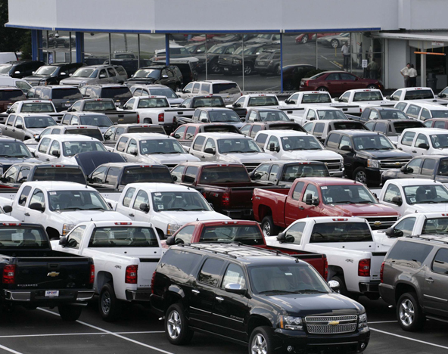
Predicting U.S. Car Preferences
IBM Applied Data Science Certificate
Martín Santiago Rivera Ritchie

Slide 2
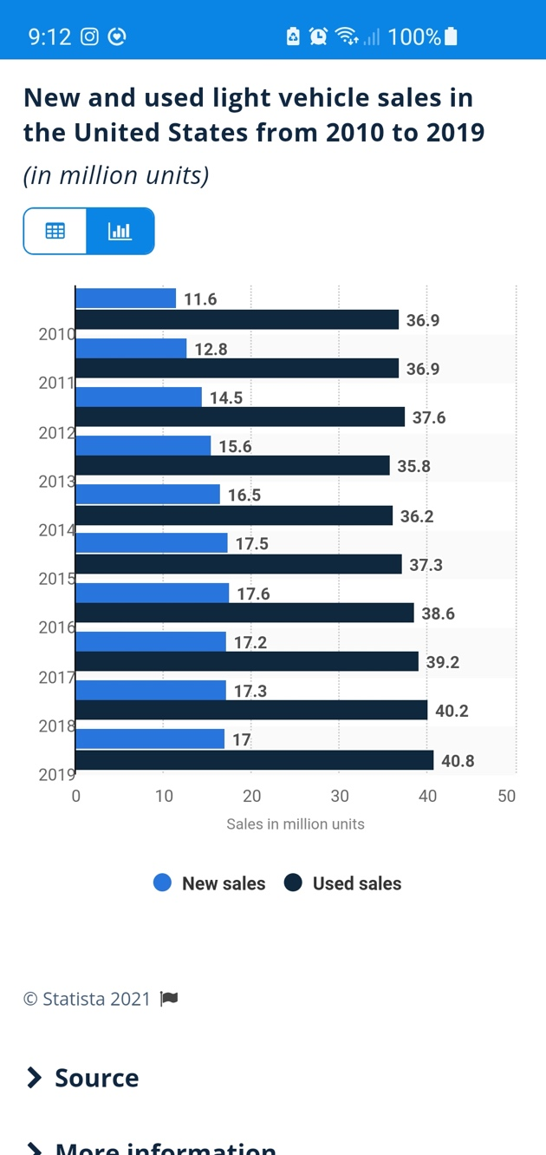
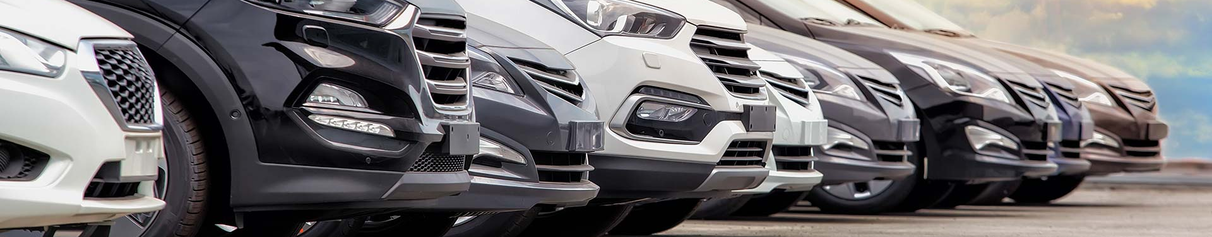
Predicting U.S. Car Preferences per State
According to Statista in 2019 an estimated 40.8% of sales made in the US were used cars, in comparison to the 17% comprised by new car sales (graph 1).
The focus of the study is directed towards Car Dealership owners and managers that wish to find which cars are the most likely to be sold in their state, and at what price range, in order to better balance their stock of new vs. used cars.

Slide 3
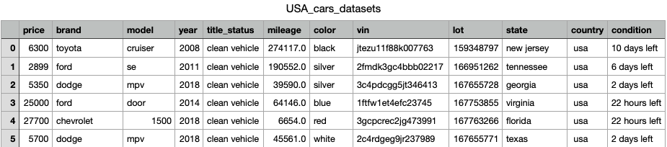
Data Source
The data that I will evaluate is one that I acquired from Kaggle called “US Cas Dataset” which in turn was scrapped from auctionexport.com.
This dataset contains
2,498 entries.
12 columns with a combination of string and numeric variables

Slide 4
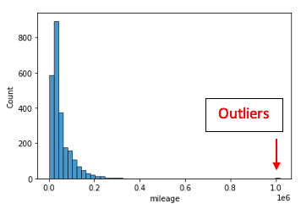
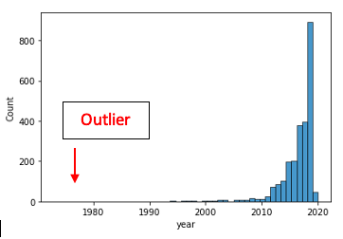
Data Cleaning & Variable Selection
From the univariate analysis the following Outliers are identified and ereased:
The max values in the column Mileage which are rows 490, 516, 528, 1827 with values over 902,041 miles.
The same is done with the variable Year which has a value of 1973.
Variable Selection Table
After removing the outliers, several variables still need to be removed because they are mostly relevant to the manufacturer and not so much the average consumer.
There are also 2 variables that need to appended in order to make prediction models.

Slide 5
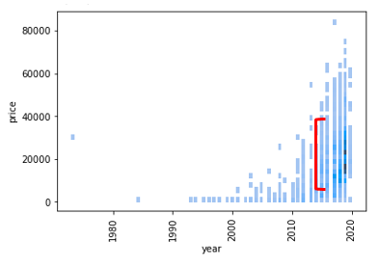
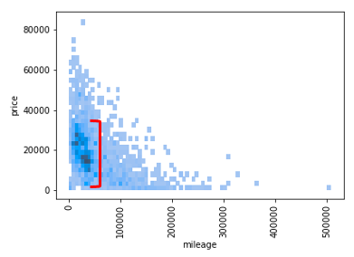
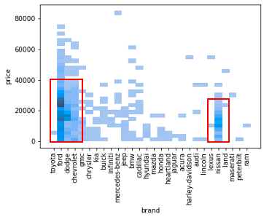
Profile
Price v. Year graph: shows a soft concentration of cars sales between the years 2018 and 2020, and a price range between $10,000 - $40,000 USD.
Price v. Mileage graph: shows a concentration of car sales with a mileage lower than 10,000 miles, and a Price range between $10,000 - $40,000 USD.
Price v. Brand graph: The graph shows the same price range for the 4 most popular brands which are Ford, Dodge, Chevrolet, and Nissan

Slide 6
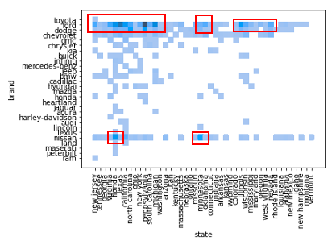
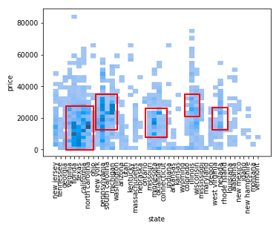
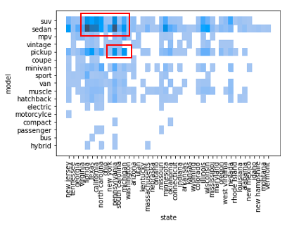
Predicting U.S. Car Preferences per State
Brand v. state graph: This histogram identifies the sates with the most sales, the top four are Florida, Texas, California, and Pennsylvania.
Price v. State graph: This graph better identifies additional states with a higher amount of car sales, which lie between the price range of $10,000-$40,000 USD.
Model v. state: The graph shows two concentrations of data, in the first one SUV’s and Sedans are the most popular models in Florida, Texas, and California. The second concentration shows pickups being the most popular models in Pennsylvania and Michigan.

Slide 7
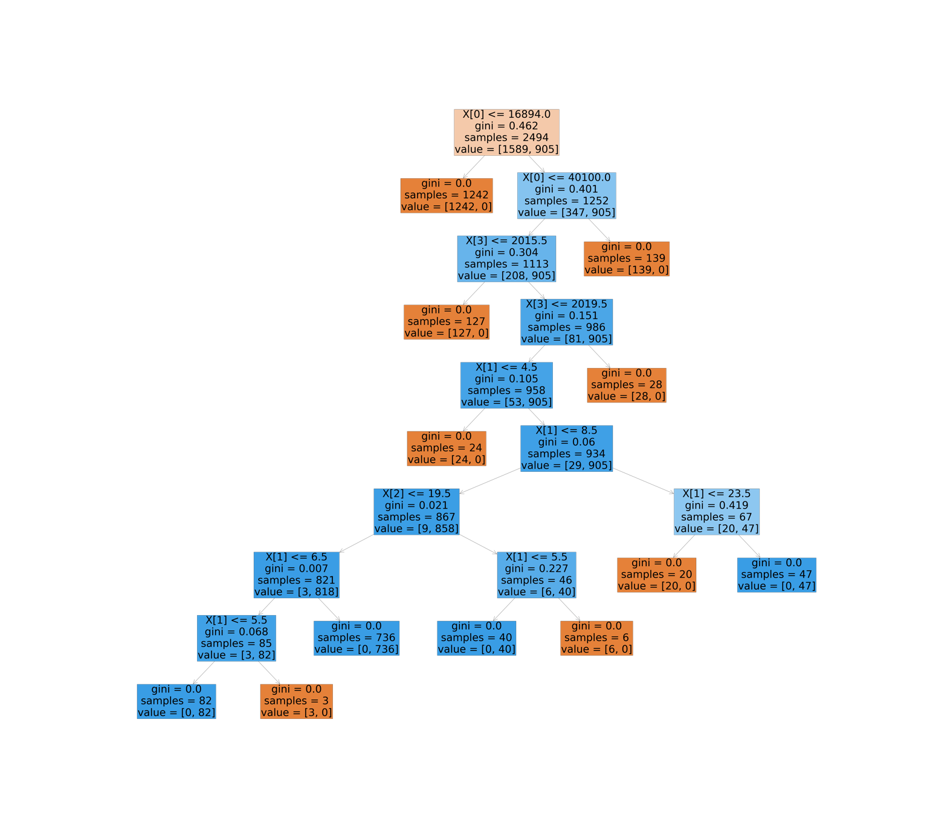
Models: Decision Tree
From this data we can tell that the consumers in the data base are not buying expensive vehicles- they prefer to buy on a budget, they prefer used cars, the most popular brand is Chevrolet, and the most popular model across all brands are SUV.
Federal profile:
Price: $16,894 USD
Year: 2015
Brand: Chevrolet
Model: SUV

Slide 8
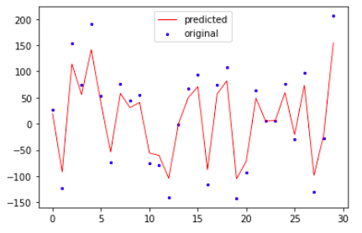
Models: Regression
From the table the model that best explains the data is the Elastic Net Regression Model with an R-Squared values of 0.89. Since I used the tree to interpret the data at the national level, I will use the Elastic Net Regression to interpret the data by state.
After training, testing, and tunning the model I end up with a Predictive Model with a R-squared value of 0.93. The following graph shows that the model, though it has a high R-squared value, it is not over fitted.

Slide 9
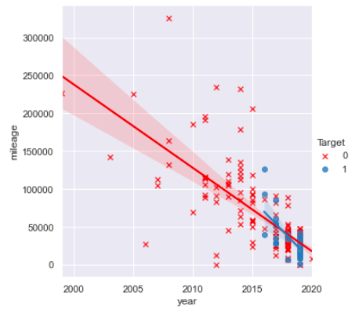
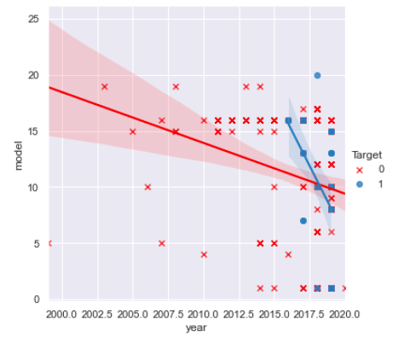
Results per State: Florida
Mileage vs. Year: From this graph we can observe that clients in Florida prefer new cars, or cars with low mileages; between 0 – 50,000 miles.
Model vs. Year: From this graph we observe that the 4 most popular models and the year they were made are 2019 4 door pickups, 2018 Minivans, and 2017 4 door sedans, and 2016 single cab pickups.

Slide 10
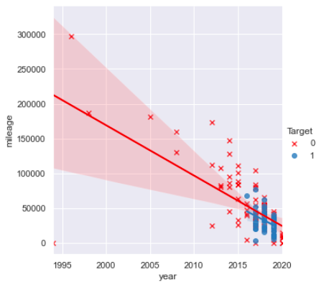
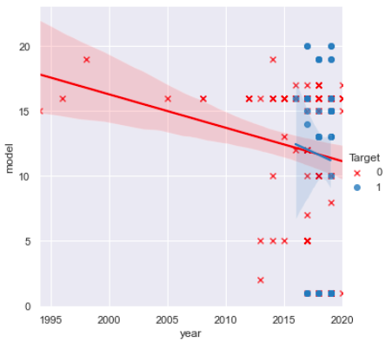
Results per State: California
Mileage vs. Year: From the graph we can see that the most popular cars are used cars with mileages between 30,000 – 50,000 miles.
Model vs. Year: From the graph we observe that the most popular years and models in California are 2019 Minivans, 2018 four door Sedans, 2017 Electric cars, 2016 Motorcycles.

Slide 11
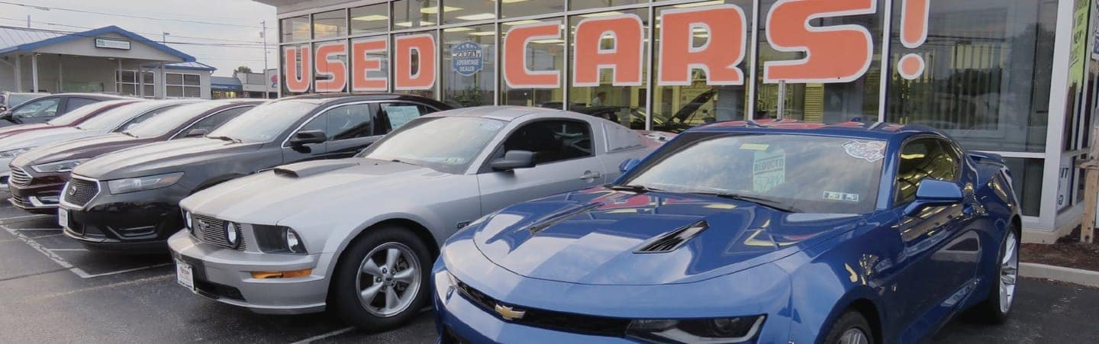
Conclusions & Future Directions
Conclusions:
The models confirm that there is a propensity for costumers to purchase used cars.
The model was able to detect the different preferences per state, for example . In Florida we see a preference towards minivans and pickups, while in California there’s a propensity for electric cars and motorcycles.
Future Directions:
For future directions it would be useful to have a wider range of consumer data. As I established in the data acquisition portion, the data used belongs to a single auction website, and as such it is a small representation of the overall market
With a broader data base new trends might be identified, and with a higher number of transactions, the information also becomes more indicative of purchasing patterns; after all the data base used only represents 2,498 clients of the over 200 million adults in the US.

